Slide 1

Oracle 11g: SQL
Chapter 7
User Creation and Management

Slide 2
Objectives
Explain the concept of data security
Create a new user account
Identify two types of privileges: system and object
Grant privileges to a user
Address password expiration requirements
Change the password of an existing account
Oracle 11g: SQL

Slide 3
Objectives (continued)
Create a role
Grant privileges to a role
Assign a user to a role
View privilege information
Revoke privileges from a user and a role
Remove a user and roles
Oracle 11g: SQL

Slide 4
Data Security
User accounts provide a method of authentication
They can grant access to specific objects
They identify owners of objects
Oracle 11g: SQL

Slide 5
Creating a User
The CREATE USER command gives each user a user name and password
Oracle 11g: SQL

Slide 6
Assigning User Privileges
There are two types of privileges
  System privileges
    Allow access to the database and execution of DDL operations
  Object privileges
    Allow a user to perform DML and query operations
Oracle 11g: SQL

Slide 7
Assigning User Privileges (continued)
Even with a valid user name and password, a user still needs the CREATE SESSION privilege to connect to a database
Oracle 11g: SQL

Slide 8
System Privileges
Affect a user’s ability to create, alter, and drop objects
Use of ANY keyword with an object privilege (INSERT ANY TABLE) is considered a system privilege
List of all available system privileges available through SYSTEM_PRIVILEGE_MAP
Oracle 11g: SQL

Slide 9
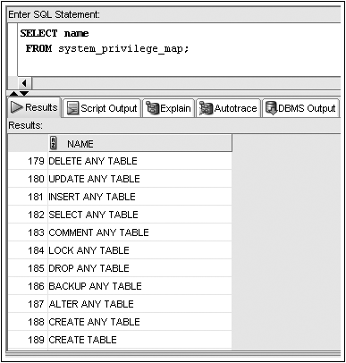
SYSTEM_PRIVILEGE_MAP

Slide 10
Granting System Privileges
GRANT clause – identifies system privileges being granted
TO clause – identifies receiving user or role
WITH ADMIN OPTION clause – allows a user to grant privilege to other database users
Oracle 11g: SQL

Slide 11
Object Privileges
SELECT – display data from table, view, or sequence
INSERT – insert data into table or view
UPDATE – change data in a table or view
DELETE – remove data from a table or view
ALTER – change definition of table or view
Oracle 11g: SQL

Slide 12
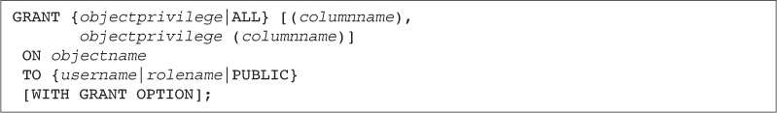
Granting Object Privileges
GRANT clause – identifies object privileges
ON clause – identifies object
TO clause – identifies user or role receiving privilege
WITH GRANT OPTION clause – gives a user the ability to assign the same privilege to other users
Oracle 11g: SQL

Slide 13
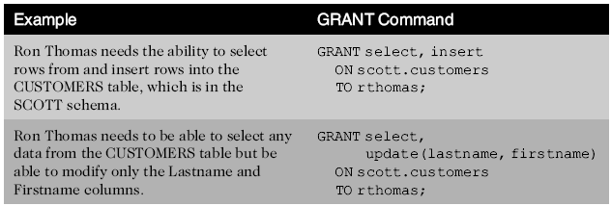
GRANT Command Examples
Oracle 11g: SQL

Slide 14
Password Management
To change a user password, use the PASSWORD command or the ALTER USER command
Oracle 11g: SQL

Slide 15
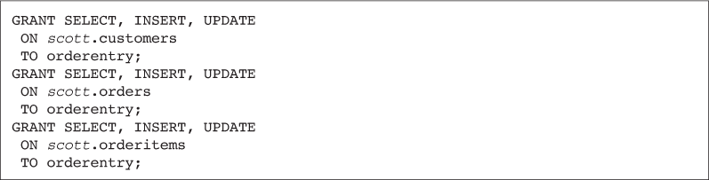
Utilizing Roles
A role is a group, or collection, of privileges
Oracle 11g: SQL

Slide 16
Utilizing Roles (continued)
Roles can be assigned to users or other roles
  A user can be assigned several roles
  All roles can be enabled at one time
  Only one role can be designated as the default role for each user
  Default role can be assigned through the ALTER USER command
Oracle 11g: SQL

Slide 17
Utilizing Roles (continued)
Roles can be modified with the ALTER ROLE command
Roles can be assigned passwords
Oracle 11g: SQL

Slide 18
Viewing Privilege Information
ROLE_SYS_PRIVS lists all system privileges assigned to a role
SESSION_PRIVS lists a user’s currently enabled roles
Oracle 11g: SQL

Slide 19
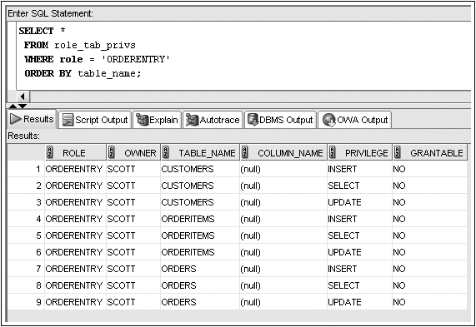
ROLE_TAB_PRIVS Example

Slide 20
Removing Privileges and Roles
Revoke system privileges or roles with the REVOKE command
Oracle 11g: SQL

Slide 21
Removing Privileges and Roles
(continued )
Revoking an object privilege – if it was originally granted using WITH GRANT OPTION, the effect cascades and is revoked from subsequent recipients
Oracle 11g: SQL

Slide 22
Dropping a Role
Users receiving privileges via a role that is dropped will no longer have those privileges available
Oracle 11g: SQL

Slide 23
Dropping a User
The DROP USER command is used to remove a user account
  CASCADE option required if user has owned objects in their schema
Oracle 11g: SQL

